Slide 1


Slide 3

TEAM
GROUP 6
ABHIRAM MANNAM
NEIL SAMUEL PULUKURI
JOSHUA HAWLEY
KUSHAL RAM TAYI

Slide 4




THE PROBLEM
HOME CREDIT
UNDERSERVED
SHADY LENDERS
SAFE BORROWING
THE CLIENT
THE CUSTOMERS
PREDATORS
THE GOAL
Notes:
The main problem is the issue of credit default risk at Home Credit, a company that seeks to provide loans to individuals with insufficient or nonexistent credit histories. This underserved population often faces exploitation by unreliable lenders, making it crucial for Home Credit to ensure a positive and safe borrowing experience.
The goal is to give the company a clearer understanding of the potential clients and their repayment risks. This will ensure that customers who are able to repay will be given the credit opportunity.

Slide 5

It is not a calculated risk if you haven’t calculated it.
Naved Abdali

Slide 6
PROCESS
Statistical Analysis
Hypothesis Testing
Know where we are going
Are our assumptions plausible?
01
02
03
04
05
Descriptive Analysis
Modeling Analysis
Exploratory Data Analysis
Know where we are
How to get there
Clean and prep the data
Notes:
There are numerous statistical and machine learning models that can be used to attack this problem.

Slide 7
EDA

Slide 8
CLASS IMBALANCE
90%
DENIED – MAJORITY CLASS

Slide 9
HYPOTHESIS

Slide 10

INCOME
Income doesn’t have effect on the default rate.
Boxplot provides that with default as 0 and 1 there is no major difference (except for some outliers).

Slide 11
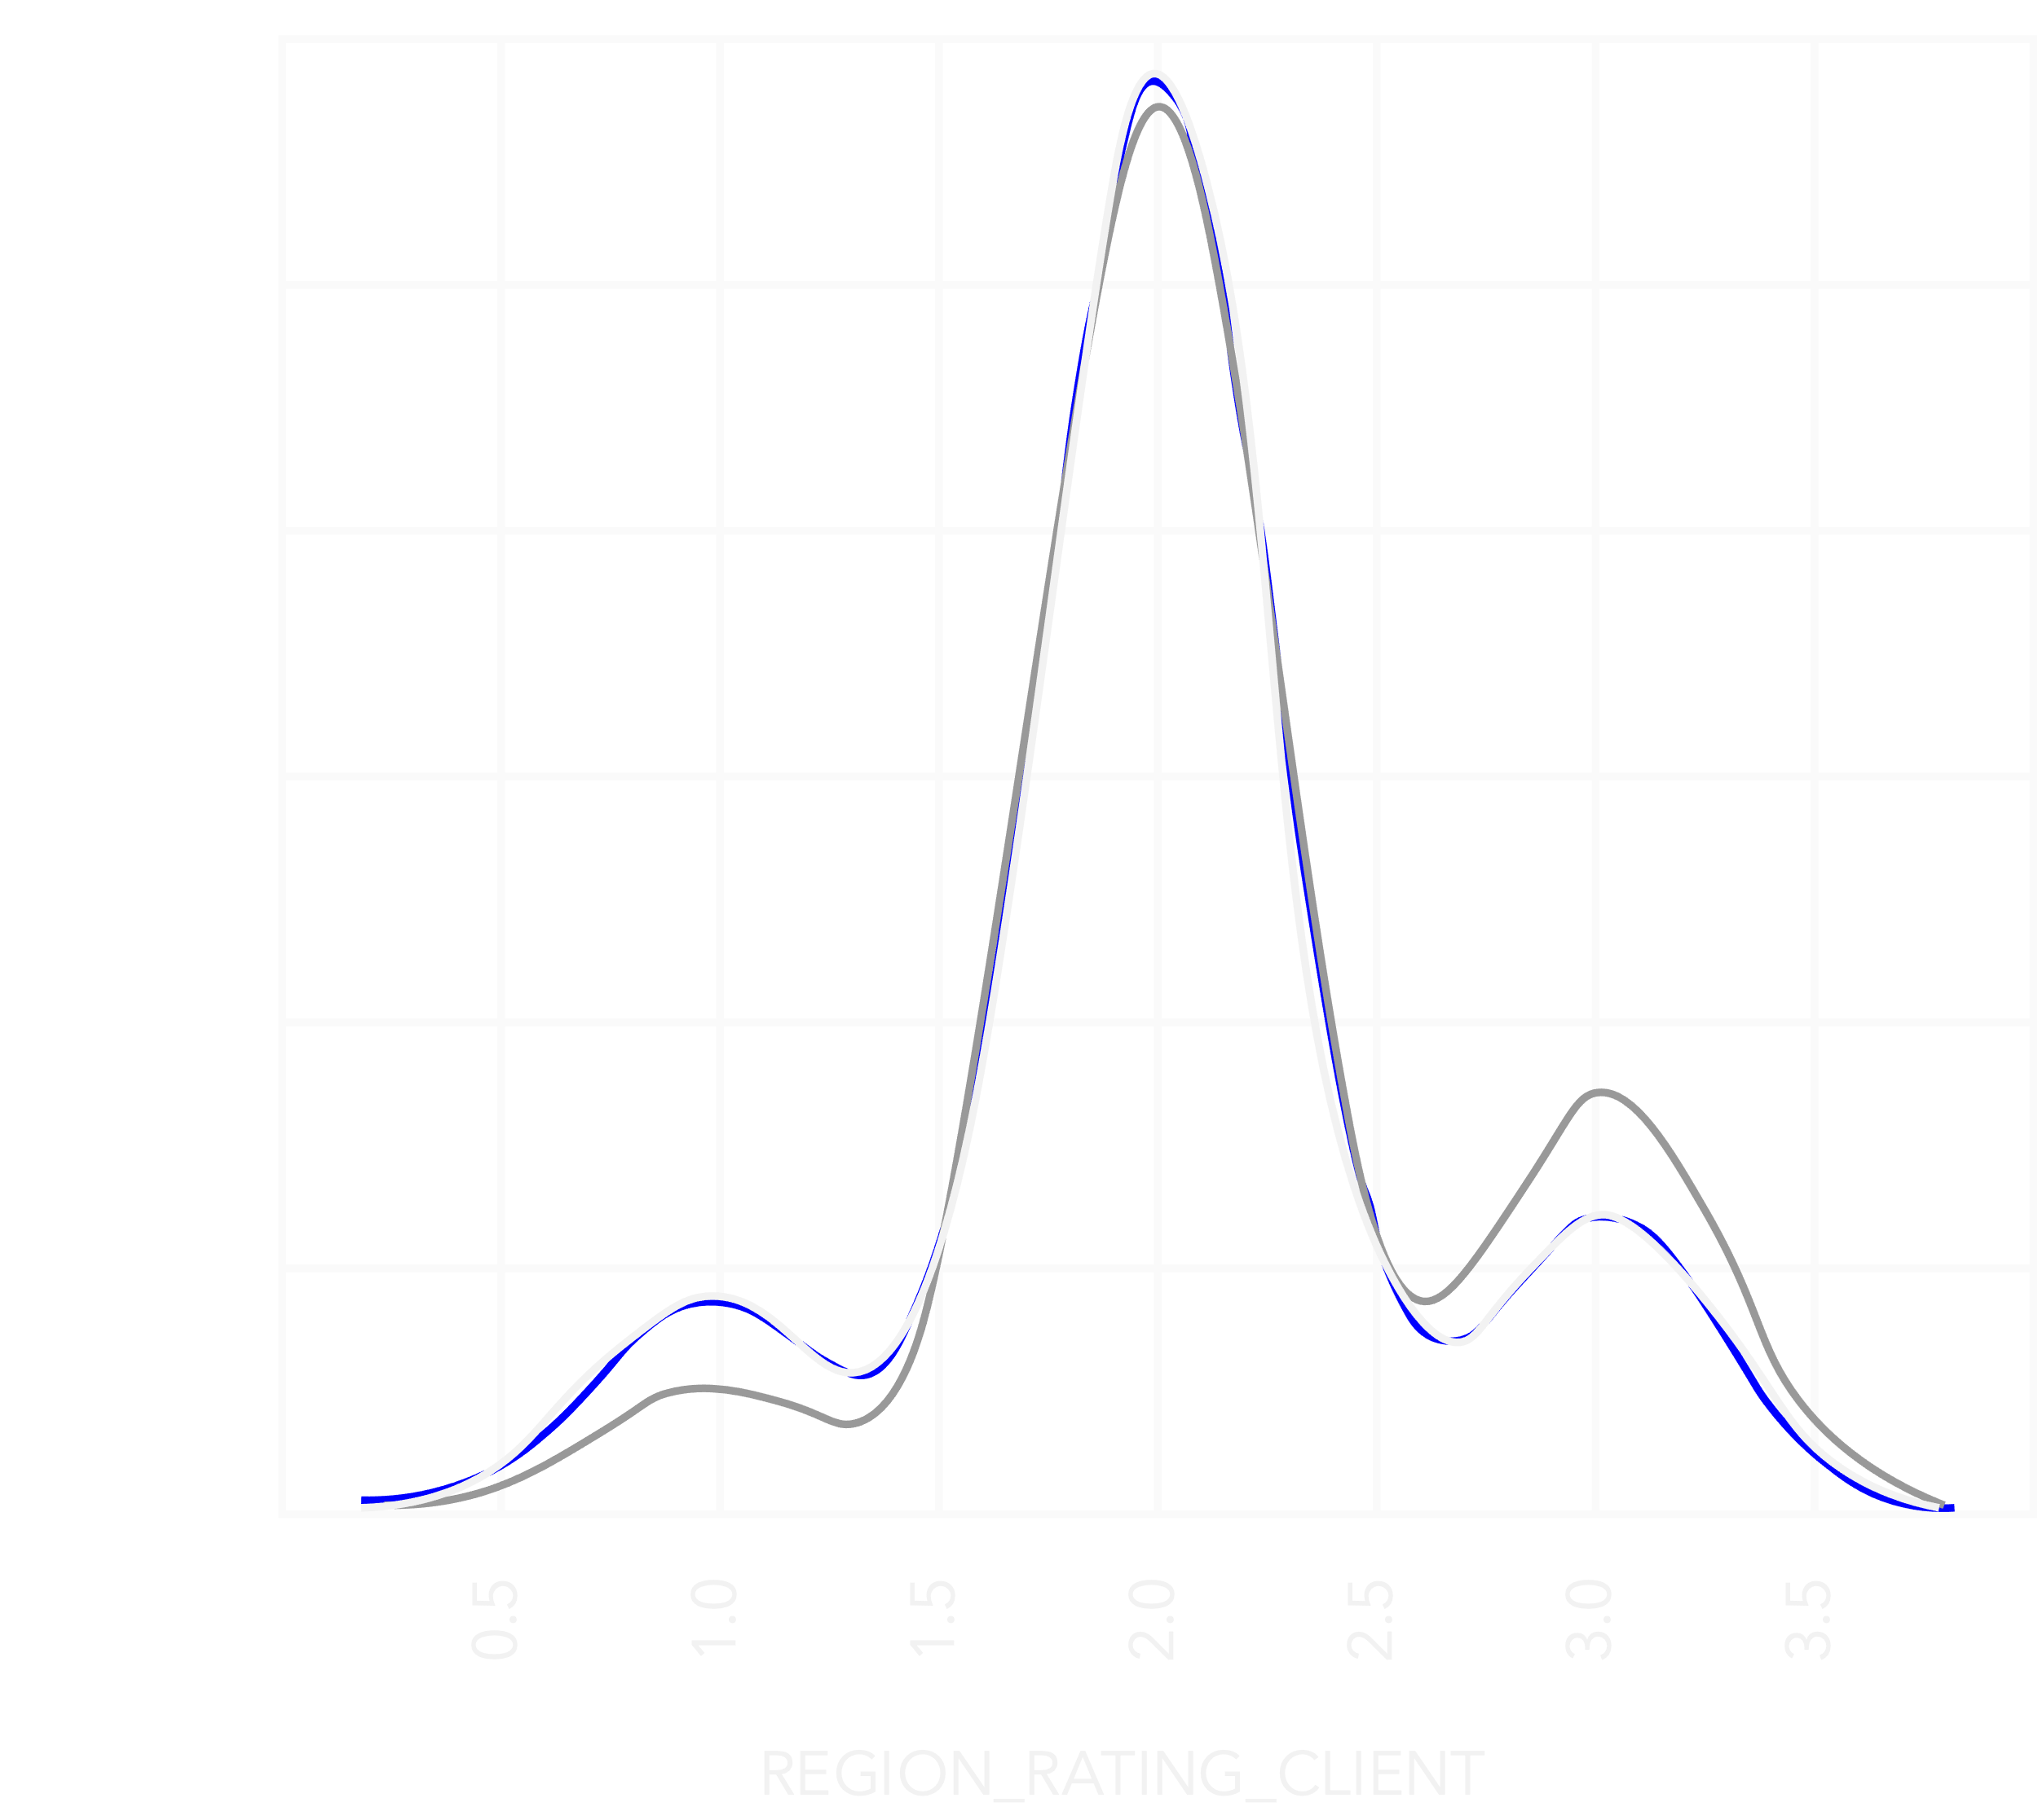
REGION RATING
The region ratings has ratings from 0 to 4 where 4 is low rated area and 0 as high rated.
For right part from 2.5 to 4 of the region rating we can see there is high risk of default whereas for the region rating of 0 to 1.5 on the left side of the plot has less default risk.
Region rating has an effect on the default rate.

Slide 12
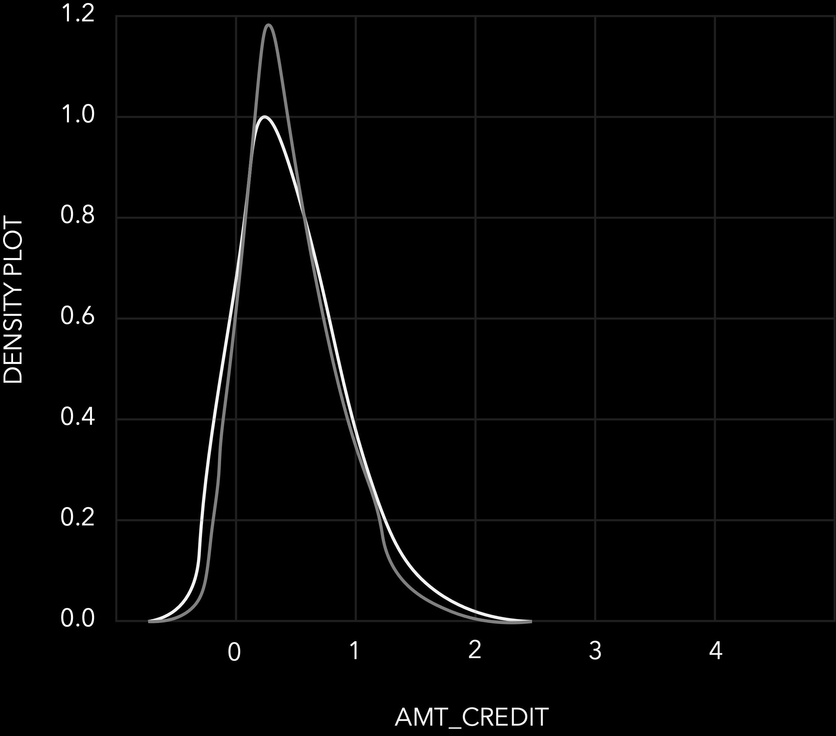
AMOUNT CREDIT
From the density plot the amount credit has no effect
on the default rate.
The two plots have the same pattern for the default rate.

Slide 13
STATISTICAL AND PREDICTIVE
MODELS ANALYSIS

Slide 14
MODEL EVALUATION
KAGGLE SCORE FOR EACH MODEL
Logistic Regression
Random Forest
Light Gradient Boost
LASSO
XGBoost
.68
.69
.67
.71
.72
Notes:
Each model and their score. This can be talked about regarding hyperparameter tuning

Slide 15
CONFUSION MATRIX
LIGHT GRADIENT BOOST
GROUND TRUTH
TRUE
.67
FALSE
SENSITIVITY
3360
1501
TRUE
.69
PREDICTED
PRECISION
1657
3452
FALSE
.69
SPECIFICITY

Slide 16

IMPORTANT FEATURES

Slide 17
IMPORTANT FEATURES
Amt_Goods_Price | -0.039
Days_Birth | 0.078
Amt_Annuity | -0.012
Region_Population | -0.037
Region_Rating | 0.058
Correlation

Slide 18
CONCLUSION
The financial Institutions should concentrate on the goods for which the credit has been provided.
The region rating and also region population has an effect on the default rate.
The annual credit amount has an effect on the default rate.
The age of the customer has an effect on the repayment rate as the younger people are more likely to default.

Slide 19
THANKS
FOR LISTENING

